Slide 1

Database Administrator
Team MBD

Slide 2
LAST EXERCISE
0

Slide 3
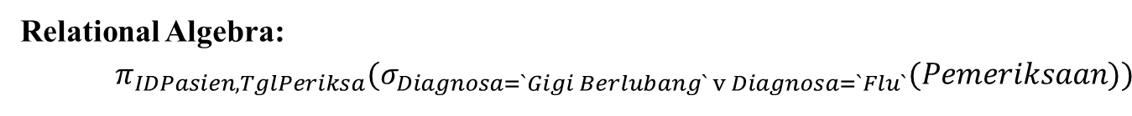
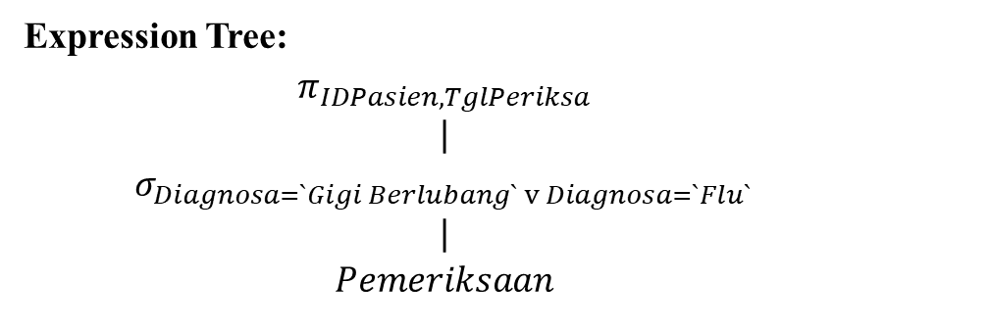
Select id of patient and check date of patient who got “Gigi Berlubang” or “Flu
Relational Algebra:
$$π_{IDPasien,TglPeriksa}(σ_{Diagnosa=`Gigi Berlubang` v Diagnosa=`Flu`}(Pemeriksaan))$$
Expression Tree:
$$π_{IDPasien,TglPeriksa}$$
$$|$$
$$σ_{Diagnosa=`Gigi Berlubang` v Diagnosa=`Flu` }$$
$$|$$
$$Pemeriksaan$$
IDPasien | TglPeriksa
PS00007 | 02-Jan-15
PS00007 | 10-Feb-15
Notes:
Select a pair of doctors who are in the same poly (a pair cannot contain of same doctor)
Select patients who had been checked in all poly

Slide 4

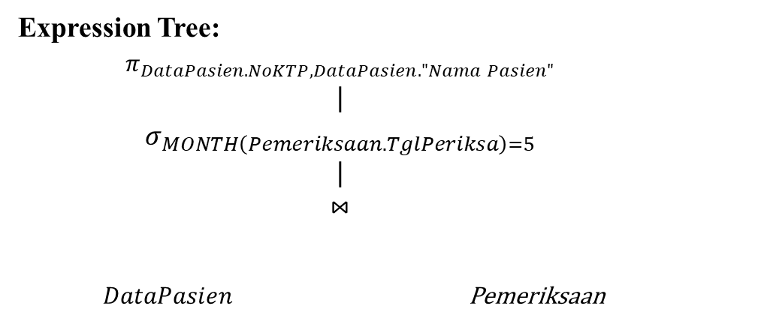
Select KTP number and name of patients who checked on May
Relational Algebra:
$$π_{NoKTP,"Nama Pasien"}(σ_{MONTH\left(TglPeriksa\right)=5}\left(DataPasien⋈Pemeriksaan\right))$$
Expression Tree:
$$π_{DataPasien.NoKTP,DataPasien."Nama Pasien"}$$
$$|$$
$$σ_{MONTH\left(Pemeriksaan.TglPeriksa\right)=5}$$
$$|$$
$$⋈$$
$DataPasien$ Pemeriksaan
NoKTP | Nama Pasien
3606125204940003 | Yutika Amelia Effendi
Notes:
Select a pair of doctors who are in the same poly (a pair cannot contain of same doctor)
Select patients who had been checked in all poly

Slide 5


Select name of patients, name of doctors, the doctor’s poly, and check date of patients who handled by doctor Dr. Budikusnaedi
Relational Algebra:
$$π_{"Nama Pasien", Nama, NamaPoli, TglPeriksa}$$
$(DataPasien$ $⋈(Pemeriksaan⋈\left(Poli⋈\left(σ_{Dokter.Nama=`Dr. Budikusnaedi`}\left(Dokter\right)\right)\right)))$
Expression Tree:
$$π_{"Nama Pasien", Nama.NamaPoli,TglPeriksa}$$
$$|$$
$$⋈$$
$DataPasien$ $⋈$
$Pemeriksaan$ $⋈$
$Poli σ_{Dokter.Nama=`Dr. Budikusnaedi`}$
$$|$$
$$Dokter$$
Nama Pasien | Nama | NamaPoli | TglPeriksa
Lidra Trifidya | Dr. Budikusnaedi | Bedah Umum | 01-Jan-15
Yutika Amelia Effendi | Dr. Budikusnaedi | Bedah Umum | 02-May-15
Notes:
Select a pair of doctors who are in the same poly (a pair cannot contain of same doctor)
Select patients who had been checked in all poly

Slide 6
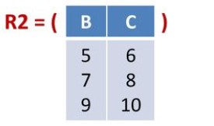
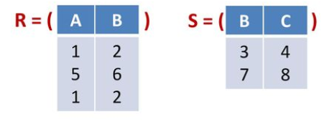


Fill the results of the questions based on the below tables
$σ_{A∗B>5}(R)$=
$π_{C}(R2)$ =
$R ×S=$
$R⋈_{R.B<R2.C}R2$ =
$π_{C} (S⋈\left(R⋈R2\right))$=
Tidak ada hasil pada Kolom C
A | B
5 | 6
A | B | B | C
1 | 2 | 5 | 6
1 | 2 | 7 | 8
1 | 2 | 9 | 10
5 | 6 | 7 | 8
5 | 6 | 9 | 10
1 | 2 | 5 | 6
1 | 2 | 7 | 8
1 | 2 | 9 | 10
C
6
8
10
A | B | B | C
1 | 2 | 3 | 4
5 | 6 | 3 | 4
1 | 2 | 3 | 4
1 | 2 | 7 | 8
5 | 6 | 7 | 8
1 | 2 | 7 | 8

Slide 7
DATABASE ADMINISTRATOR
User Management
Grant / Revoke Privileges
Backup / Restore Database

Slide 8
USER MANAGEMENT
1

Slide 9
USER AND ROLES
Role = an entity than can own database objects and have database privileges (a role can be a “user” or a “group”)
User = Role + Login
Create User
Syntax : CREATE USER NameofUser WITH [ENCRYPTED] PASSWORD NameofPassword
CREATE USER User1 WITH PASSWORD ‘password1’
Create Role
Syntax : CREATE NameofRole
CREATE Role1;

Slide 10
ALTER AND DROP
A. Mengganti Password untuk User
Syntax: ALTER USER NameofUser WITH PASSWORD NameNewPassword
B. Memberikan akses bagi Role untuk membuat database
Syntax: ALTER ROLE NameofRole CREATEDB
C. Menghapus User
Syntax: DROP USER / DROP ROLE [IF EXISTS] NameofUser

Slide 11
GRANT / REVOKE PRIVILEGE
2

Slide 12
PRIVILEGES
Users with superuser privilege can do any activities in the database
User who creates the table owns the table and he can only see or modify the data other than superusers
Other users who want to view the data in tables owned by others neeed privileges on the table

Slide 13
PRIVILEGES ASSIGNED TO USERS
Privileges
Users
Table1
User1
Table2
User2
Syntax : GRANT privilege ON NameofTable to NameofUser
GRANT Select ON Table1 to User1;
GRANT Select ON Table1 to User2;
GRANT Select, Insert ON Table2 to User1;
GRANT Select, Insert ON Table2 to User2;

Slide 14
PRIVILEGES ASSIGNED VIA ROLES TO USERS
Privileges
Users
Table1
User1
Role1
Table2
User2
Syntax : GRANT privilege on NameofTable to NameofRole
GRANT Select on Table1 to Role1;
GRANT Select, Insert on Table2 to Role1;
Syntax : GRANT NameofRole to NameofUser
GRANT Role1 to User1;
GRANT Role1 to User2;

Slide 15
GRANT / REVOKE PRIVILEGES
Grant / Revoke Privileges: pemberian / pencabutan hak atas objek database di tabel
A. Grant Privileges terhadap Tabel
GRANT privilege ON table_name TO user_name
B. Revoke Privileges terhadap Tabel
REVOKE privilege ON table_name FROM user_name

Slide 16
BACKUP / RESTORE
3

Slide 17

BACKUP / RESTORE
Macam-macam Penyebab Kehilangan Data
Kesalahan Software
Kesalahan Pengguna
Media Penyimpanan Eror
Kesalahan Manajemen
Kesalahan Sistem Penyimpanan
Hack
Notes:
Gambar : https://www.snow-mirror.com/recover-lost-servicenow-data/

Slide 18
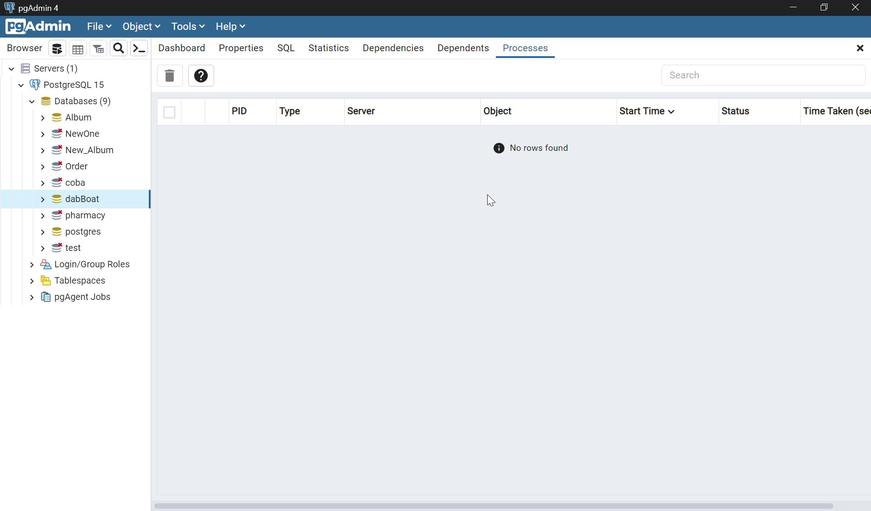
BACKUP / RESTORE

Slide 19
LATIHAN
4

Slide 20
Latihan
Latihan ini tidak mengharuskan mahasiswa menggunakan Oracle. Bisa menggunakan DBMS lain yang compatible dengan PC / laptop yang dipunya.
Gunakan database album seperti soal praktikum query.
Buatlah user berupa admin_toko dan admin_album. Tuliskan query yang dibuat dan screenshot pembuktian bahwa user sudah terdaftar.
Buatlah hak akses untuk kedua user tersebut menggunakan role dimana:
a. admin_toko : select, insert, update Tabel Receipt dan DetailItem serta select Tabel Singer dan Album
b. admin_album: select, insert, update Tabel Singer dan Album
Tuliskan query dan screenshot pembuktian hak akses masing-masing user.
Buatlah 1 file backup dari database album dan restore ke database baru bernama newAlbum. Tampilkan hasil akhir berupa bukti backup telah berhasil.
Pengumpulan latihan berupa pdf berisi hasil dari latihan.

